Slide 1
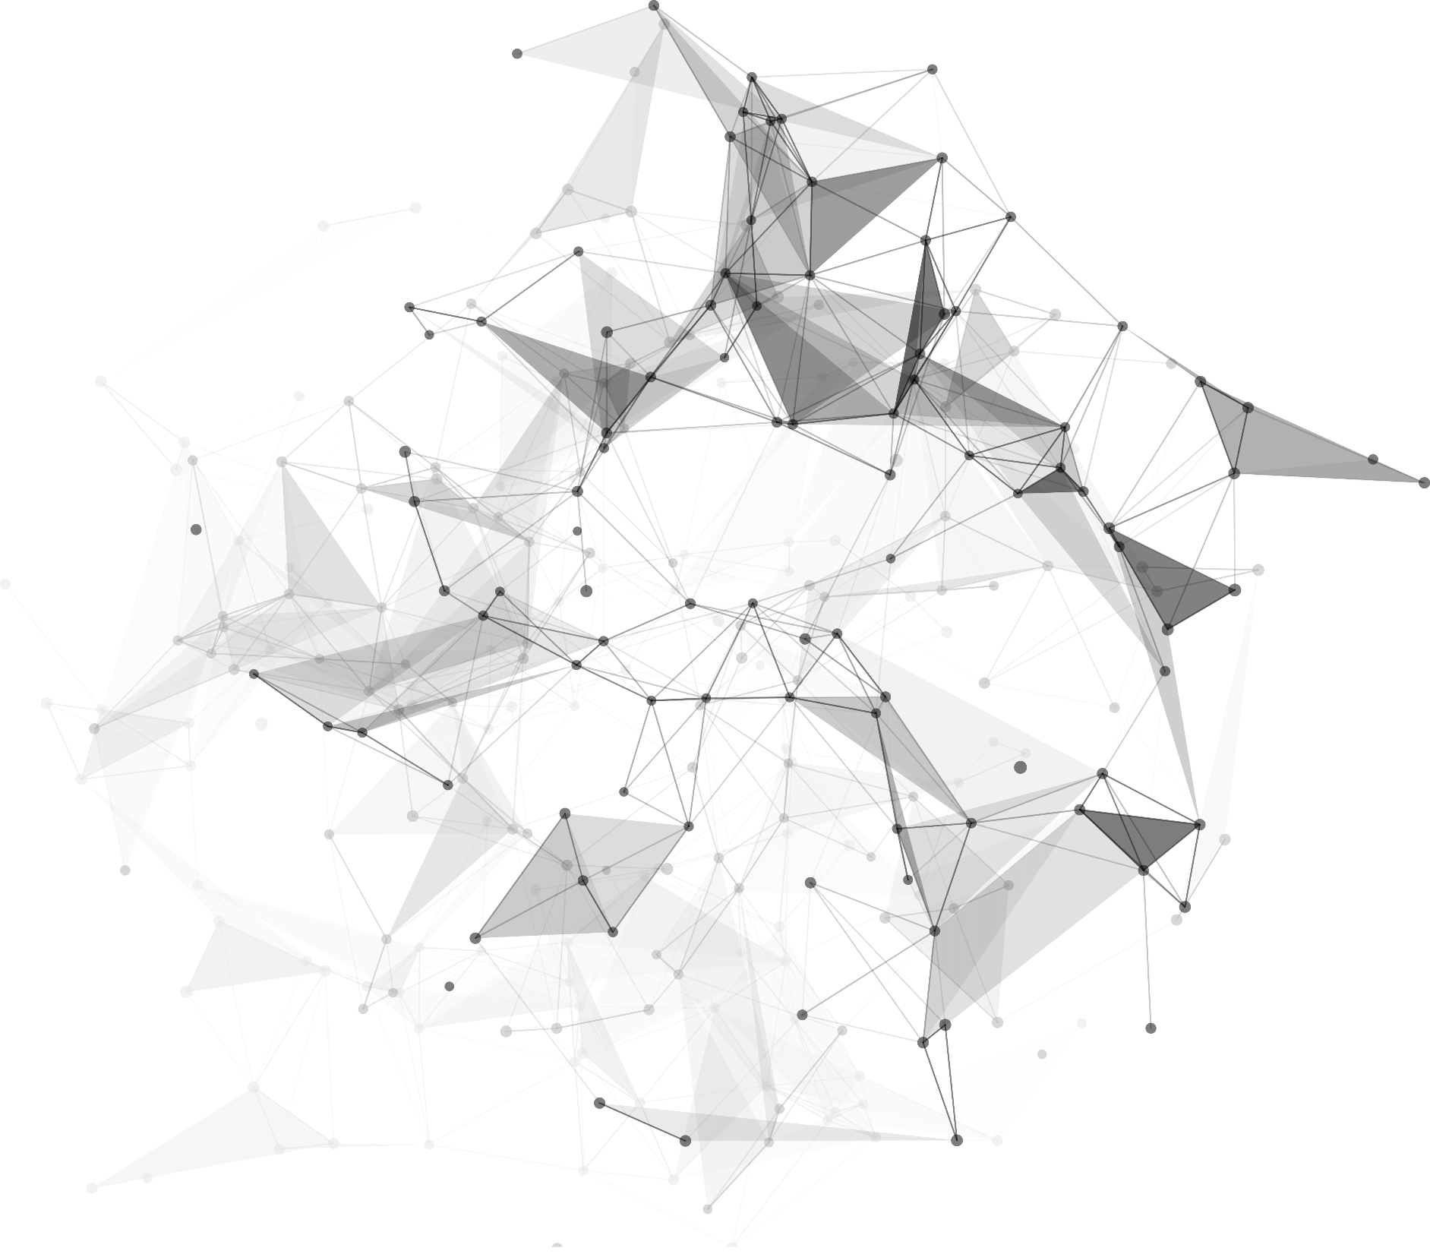

2
0
2
3
01.走进车载系统
作者 ：林栩link
邮箱 ：linxu_link@foxmail.com
博客 ：https://juejin.cn/user/870468939434039/posts
课件：https://github.com/linxu-link/CarAndroidCourse

Slide 2
目录
03
01
常见车载系统应用
车载操作系统
04
02
如何学习车载应用开发
车载Android系统

Slide 3
https://www.ypppt.com/
1
Part 01
车载操作系统

Slide 4
01
车载操作系统
运行于车载芯片上，管理和控制智能网联汽车车载软件、硬件资源的软件集合，为智能网联汽车提供除驾驶自动化功能实现以外的服务，包括 车载信息娱乐、网联、导航、多媒体娱乐、语音、辅助驾驶、AI 等服务。

Slide 5
01
车载操作系统的现状
目前，应用于车载领域的操作系统有括 QNX、Linux/AGL、RT-Linux、 AliOS、AliOS RT、Android 和鸿蒙 OS 等，各个车载操作系统的介绍参见
附录 A。车载操作系统从功能角度可分为非实时操作系统和实时操作系统；
从应用领域角度通常可分为用于中控的车载操作系统，用于仪表的车载操作系统和用于 T-box 的车载操作系统

Slide 6
01
常见车载操作系统简介 - QNX
目前，应用于车载领域的操作系统有括 QNX、Linux/AGL、RT-Linux、 AliOS、AliOS RT、Android 和鸿蒙 OS 等，各个车载操作系统的介绍参见
附录 A。车载操作系统从功能角度可分为非实时操作系统和实时操作系统；
从应用领域角度通常可分为用于中控的车载操作系统，用于仪表的车载操作系统和用于 T-box 的车载操作系统

Slide 7
01
常见车载操作系统简介 - Linux
目前，应用于车载领域的操作系统有括 QNX、Linux/AGL、RT-Linux、 AliOS、AliOS RT、Android 和鸿蒙 OS 等，各个车载操作系统的介绍参见
附录 A。车载操作系统从功能角度可分为非实时操作系统和实时操作系统；
从应用领域角度通常可分为用于中控的车载操作系统，用于仪表的车载操作系统和用于 T-box 的车载操作系统

Slide 8
01
常见车载操作系统简介 - AliOS
目前，应用于车载领域的操作系统有括 QNX、Linux/AGL、RT-Linux、 AliOS、AliOS RT、Android 和鸿蒙 OS 等，各个车载操作系统的介绍参见
附录 A。车载操作系统从功能角度可分为非实时操作系统和实时操作系统；
从应用领域角度通常可分为用于中控的车载操作系统，用于仪表的车载操作系统和用于 T-box 的车载操作系统

Slide 9
01
常见车载操作系统简介 - Android
目前，应用于车载领域的操作系统有括 QNX、Linux/AGL、RT-Linux、 AliOS、AliOS RT、Android 和鸿蒙 OS 等，各个车载操作系统的介绍参见
附录 A。车载操作系统从功能角度可分为非实时操作系统和实时操作系统；
从应用领域角度通常可分为用于中控的车载操作系统，用于仪表的车载操作系统和用于 T-box 的车载操作系统

Slide 10
01
常见车载操作系统简介 - 鸿蒙
目前

Slide 11
01
车载操作系统的基础服务
目前

Slide 12
01
车载操作系统 - 单系统架构
目前，

Slide 13
01
车载操作系统 - 多系统架构
目前，

Slide 14
01
车载操作系统 - 多系统架构
目前，

Slide 15
2
https://www.ypppt.com/
Part 02
车载Android系统

Slide 16
02
车载Android系统
目前，

Slide 17
3
https://www.ypppt.com/
Part 03
常见车载应用

Slide 18
03
系统应用 - SystemUI
目前，

Slide 19
03
系统应用 - 桌面
目前，

Slide 20
03
系统应用 - 系统设置
目前，

Slide 21
03
系统应用 - 电话
目前，

Slide 22
03
系统应用 - 电话
目前，

Slide 23
03
多媒体应用 - 收音机
目前，

Slide 24
03
多媒体应用 - 音乐
目前，

Slide 25
03
辅助应用 - 导航
目前，

Slide 26
03
辅助应用 - 语音识别&语音控制
目前，

Slide 27
03
辅助驾驶 - 倒车影像
目前，

Slide 28
03
辅助驾驶 - 盲区监控
目前，

Slide 29
03
辅助驾驶 - 全景影像
目前，

Slide 30
03
车辆控制应用 - 空调
目前，

Slide 31
03
车辆控制应用 - 车控车设
目前，

Slide 32
4
https://www.ypppt.com/
Part 04
如何学习车载应用开发

Slide 33
03
车辆控制应用 - 车控车设
目前，

Slide 34
01
2011
Knowledge can change your fate and English can accomplish future.
2014
Knowledge can change your fate and English can accomplish future.
2017
Knowledge can change your fate and English can accomplish future.

Slide 35
01
Dreamkiller
Waiting
The sun has begun to set and I hang up the smile I’ve worn all day
The sun has begun to set and I hang up the smile I’ve worn all day
Romantic
NIKI WU
The sun has begun to set and I hang up the smile I’ve worn all day
The sun has begun to set and I hang up the smile I’ve worn all day

Slide 36
01
Only things with which a man identifies himself are able to disturb his mind-only that which concern “ myself ”can give me grief.

Slide 37
01
Dreaming
If two past lovers can remain friends, it’s either they were never in love or they still are.
Knowledge
If two past lovers can remain friends, it’s either they were never in love or they still are.
Empathy
If two past lovers can remain friends, it’s either they were never in love or they still are.
Victory
If two past lovers can remain friends, it’s either they were never in love or they still are.

Slide 38
02
Pengyou
Tengxu
Wechat
Experience as your reference, prudence as your brother and hope as your sentry.
Experience as your reference, prudence as your brother and hope as your sentry.
Experience as your reference, prudence as your brother and hope as your sentry.

Slide 39
02
Dreaming
You can’t change the past，but you can ruin the present by worrying about
Empathy
You can’t change the past，but you can ruin the present by worrying
Giving
You can’t change the past，but you can ruin the present by

Slide 40
02
Click to add your text
Those who adhere to the principles of wisdom, have right attitudes, and true to their words and discharge their duties with responsibility are loved by people.
Click to add your text
Those who adhere to the principles of wisdom, have right attitudes, and true to their words and discharge their duties with responsibility are loved by people.

Slide 41


02
Dreaming
You can’t change the past，but you can ruin the present by worrying about
Empathy
You can’t change the past，but you can ruin the present by worrying
Giving
You can’t change the past，but you can ruin the present by
Notes:
https://www.ypppt.com/

Slide 42
02
Whatever
It is well worth of falling love in someone even

Slide 43
3
Part 3
Memories, beautiful very hurt, memories, memories of the past but can not go back.You can be happy to live just by yourself.

Slide 44
03
morning just in case it is “that day.” I want her to see me at my very best.
S
And then there are times I get that lump in my throat and that tight feeling in my chest,
W
O
It is well worth of falling love in someone even
T
It is well worth of falling love in someone，even can keep up with the unavoidable

Slide 45
03
Dreaming
Let's take steps to banish some of the most common negative thoughts many of us repeat to ourselves. Being in a negative space is harmful to our overall well-being, because what you dwell on can easily become self fulfilling if you don't change you r mindset.
Avecle
Waiting
Waiting
Then I ask myself, “Is this the day?” And the excitement rushes over me again. And then I ask myself, “Where’s it going to be?”
Soleil

Slide 46
03
Knowledge
Knowledge
I do the normal routine, eat dinner, clean the house
I do the normal routine, eat dinner, clean the house
Knowledge
Knowledge
Knowledge
I do the normal routine, eat dinner, clean the house
I do the normal routine, eat dinner, clean the house
I do the normal routine, eat dinner, clean the house

Slide 47

03
Knowledge
Knowledge
I do the normal routine, eat dinner, clean the house
I do the normal routine, eat dinner, clean the house
16344￥
45784￥
16344￥
45784￥
Knowledge
Knowledge
I do the normal routine, eat dinner, clean the house
I do the normal routine, eat dinner, clean the house

Slide 48

03
Temptation
Then I ask myself, “Is this the day?” And the excitement rushes over me again. And then I ask myself, “Where’s it going to be?” think about her. And sometimes I smile, and sometimes that urn into a burst of laughter.

Slide 49
04
13.3%
46.7%
78.2%
European
China
United States
8.6%
Australia
Business Template
Those who adhere to the principles of wisdom, have right attitudes, and true to their words and discharge their duties with responsibility are loved by people. Make haste in doing good, restrain your mind from evil. Whosoever is slow in doing well, his mind delights in evil?

Slide 50

04
Those who adhere to the principles of wisdom, have right attitudes, and true to their words and discharge their duties with responsibility are loved by people.
2014\09
2015\11
Those who adhere to the principles of wisdom, have right attitudes, and true to their words and discharge their duties with responsibility are loved by people.

Slide 51
04
18%
Bonds
57%
25%
Dream
Quiet
He who sees other’s faults is ever irritable, the corruptions of such as one grows. He is far from the destruction of the corruptions. Those who adhere to the principles of wisdom, have right attitudes, and true to their words and discharge their duties with

Slide 52
04
75.8%
Photoshop
Adobe Illustrator
You cannot improve your past, but you can improve your future. Once time is wasted, life is wasted.
Don't aim for success if you want it; just do what you love and believe in, and it will come naturally. Knowledge can change your fate and English can .
You cannot improve your past, but you can improve your future. Once time is wasted, life is wasted.

Slide 53
c
04
Those who adhere to the principles of wisdom, have right attitudes, and true to their words and discharge their duties with responsibility are
2
Those who adhere to the principles of wisdom, have right attitudes, and true to their words and discharge their duties with responsibility are
1
AIM AT

Slide 54
Thank You
.
.
.

